Slide 1

DEPARTMENT OF COMPUTER SCIENCE AND ENGINEERING
CS3811-PROJECT WORK REVIEW

Slide 2
PROJECT TITLE :
Search System Using Elasticsearch with Redis-Based Caching
BATCH NUMBER:
MEMBER 1: Anwarsha K (920822104013)
MEMBER 2: Akash S (920822104008)
MEMBER 3: Manikandan R (920822104051)
PROJECT GUIDE: Mrs. S. Sharmila Jeyarani, AP/CSE

Slide 3
ABSTRACT
Modern applications require fast and efficient search systems for handling large data and real-time queries. Traditional systems face high latency and increased load, especially for repeated searches.
This project proposes a search system using Elasticsearch with Redis-based caching to improve performance. It also includes speech-to-text input and a profanity filter for better usability and security.
The system reduces response time, improves scalability, and enhances user experience.

Slide 4
INTRODUCTION
Search is essential in modern applications E-commerce, Enterprise search, Log analytics, Knowledge systems
Current Challenges Large data volume Frequent & repeated queries Slow response time
Technologies Used Elasticsearch - Fast search engine Redis - In-memory caching Node.js & React - Web application stack

Slide 5
PROBLEM STATEMENT
Modern applications require fast and efficient search
Traditional systems cause high latency and server load
Poor handling of repeated queries
No caching, voice support, or safety features
Leads to slow response and poor user experience

Slide 6
EXISTING SYSTEM
Uses traditional SQL-based search
Each query processed repeatedly
No caching mechanism
High response time
Heavy database load
Poor scalability for large data

Slide 7
PROPOSED SYSTEM
Uses Elasticsearch for fast search
Redis caching for repeated queries
Cache-aside strategy used
Reduced response time
Improved performance and scalability
Suitable for real-time applications

Slide 8
OBJECTIVES
To develop a fast and efficient search system using Elasticsearch.
To reduce search response time using Redis-based caching.
To minimize server load by storing frequently searched queries.
To support both text and speech-based search input.
To ensure safe searching using a profanity filtering module.
To design a scalable and user-friendly web application.

Slide 9
LITERATURE SURVEY
PAPER | Author and Year | TECHNIQUE | ADVANTAGE | LIMITATION
RAPO | Zhu et al. (2025) | Redis Optimization | Improves Performance | Not focused on search
Elasticsearch | Kathare et al. (2022) | Inverted Index | Fast Search | No caching
Redis | Kaptosv (2025) | In-Memory cache | Low Latency | Needs Integration
Inverted Index | Zobel and Moffat (2006) | Indexing | Fast Retrieval | Storage overhead

Slide 10
METHODOLOGY ( HARDWARE REQUIREMENT)
Processor: Intel Core i3 or equivalent
RAM: 4 GB
Storage: 20 GB free space
Network: Internet connection
GPU: Optional
Display: HD Monitor for System interaction

Slide 11

METHODOLOGY ( SOFTWARE REQUIREMENT)
Operating System: Windows 10/11 or Linux
Frontend: React.js
Backend: Node.js
Search Engine: Elasticsearch
Caching System: Redis
Programming Language: JavaScript
Database Tools: PostgreSQL (for comparison)
API Testing: Postman
Version Control: Git & GitHub

Slide 12
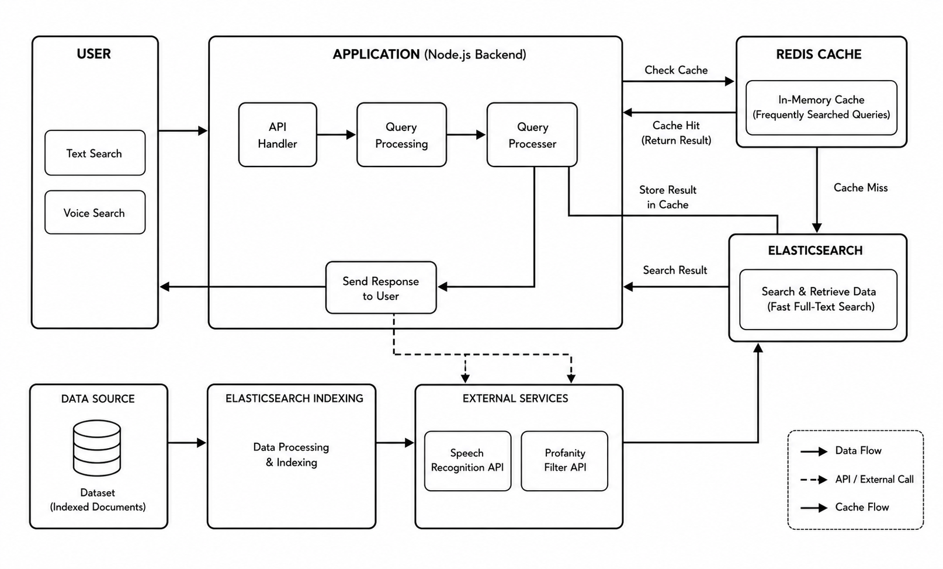
OVERALL DESIGN

Slide 13
SUMMARY OF ALGORITHMS AND HIGHLIGHTS OF THE PROJECT FEATURES
Algorithms Used:
Cache-Aside (Redis) - Stores frequent queries and reduces latency
Inverted Index (Elasticsearch) -Enables fast search
Query Processing - Routes requests between cache and search engine
Project Features:
Fast Search Response (1-20 ms)
Reduced Latency using Redis Cache
Speech-to-Text Search
Profanity Filtering

Slide 14
PROGRESS (98% COMPLETED)
Data Collection & Preprocessing – 100%
Elasticsearch Integration – 100%
Redis Caching Implementation – 100%
Backend Development (Node.js) – 100%
Frontend Development (React) – 100%
Testing & Performance Evaluation – 100%
Documentation & Report – 95%

Slide 15
METHODOLOGY/APPROACH LIST OF MODULES
USER INTERFACE
BACKEND API
REDIS CACHE MODULE
ELASTICSEARCH MODULE
SPEECH TO TEXT MODULE
PROFANITY FILTER MODULE

Slide 16
METHODOLOGY/APPROACH ( MODULES DESCRIPTION)
USER INTERFACE
Provides an interactive interface for users to enter search queries.
Supports both text and voice-based input.
Displays results quickly and clearly.
BACKEND API
Handles client requests and processes search queries.
Connects frontend with cache and search engine.
Ensures smooth data flow and response delivery.

Slide 17
METHODOLOGY/APPROACH ( MODULES DESCRIPTION)
REDIS CACHE MODULE
Stores frequently searched queries in memory.
Reduces repeated processing and latency.
Improves performance using cache-aside strategy.
ELASTICSEARCH MODULE
Performs fast full-text search using inverted index.
Retrieves relevant data from large datasets.
Ensures scalable and efficient search.

Slide 18
METHODOLOGY/APPROACH ( MODULES DESCRIPTION)
SPEECH TO TEXT MODULE
Converts voice input into text.
Enables voice-based search functionality.
Improves accessibility and user experience.
PROFANITY FILTER MODULE
Filters inappropriate or offensive words.
Ensures safe and clean queries.
Enhances usability and content security.

Slide 19
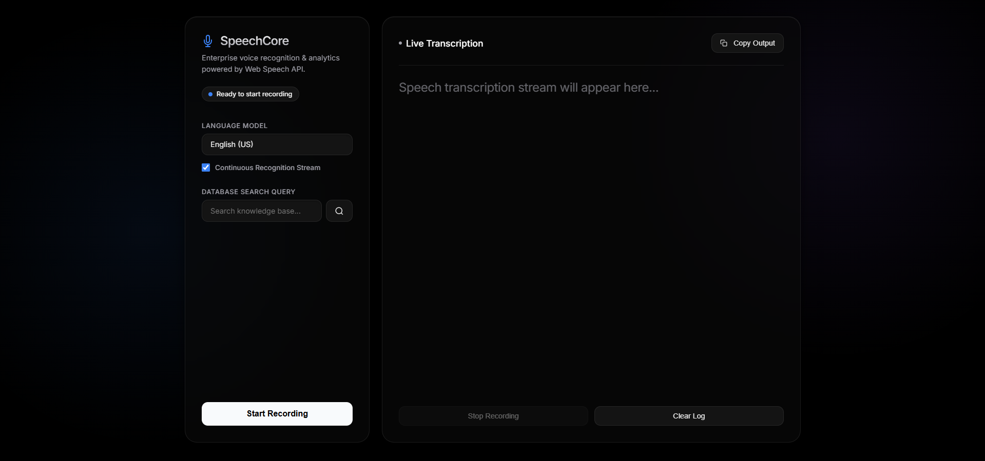
IMPLEMENTATION & PROGRESS

Slide 20
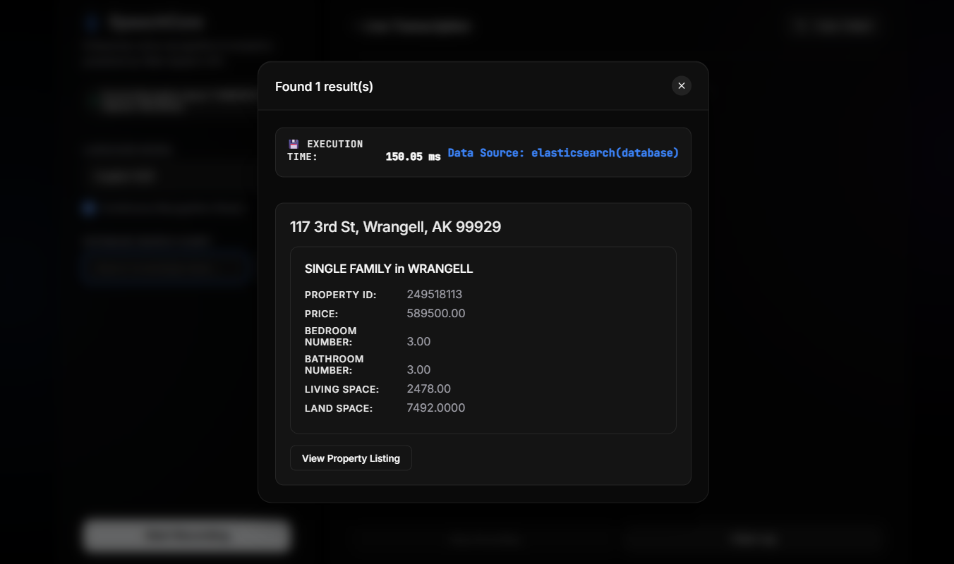
IMPLEMENTATION & PROGRESS

Slide 21
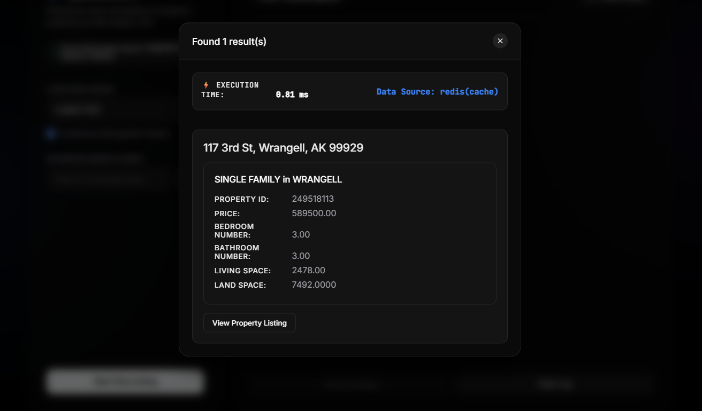
IMPLEMENTATION & PROGRESS

Slide 22
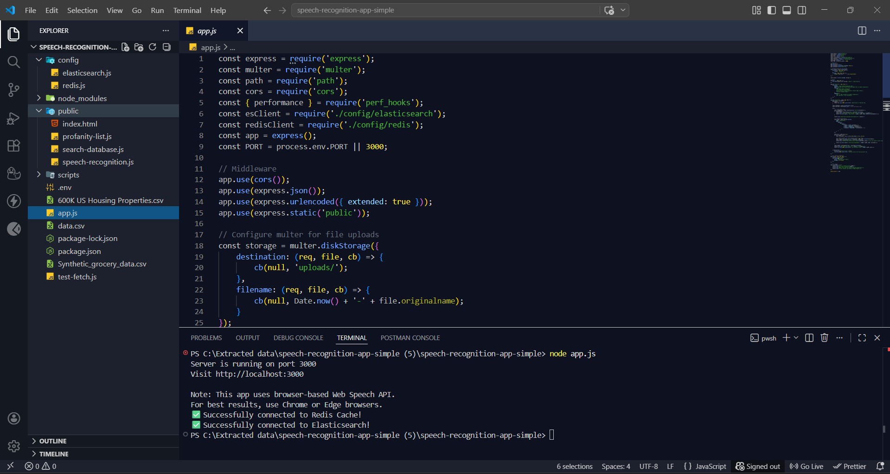
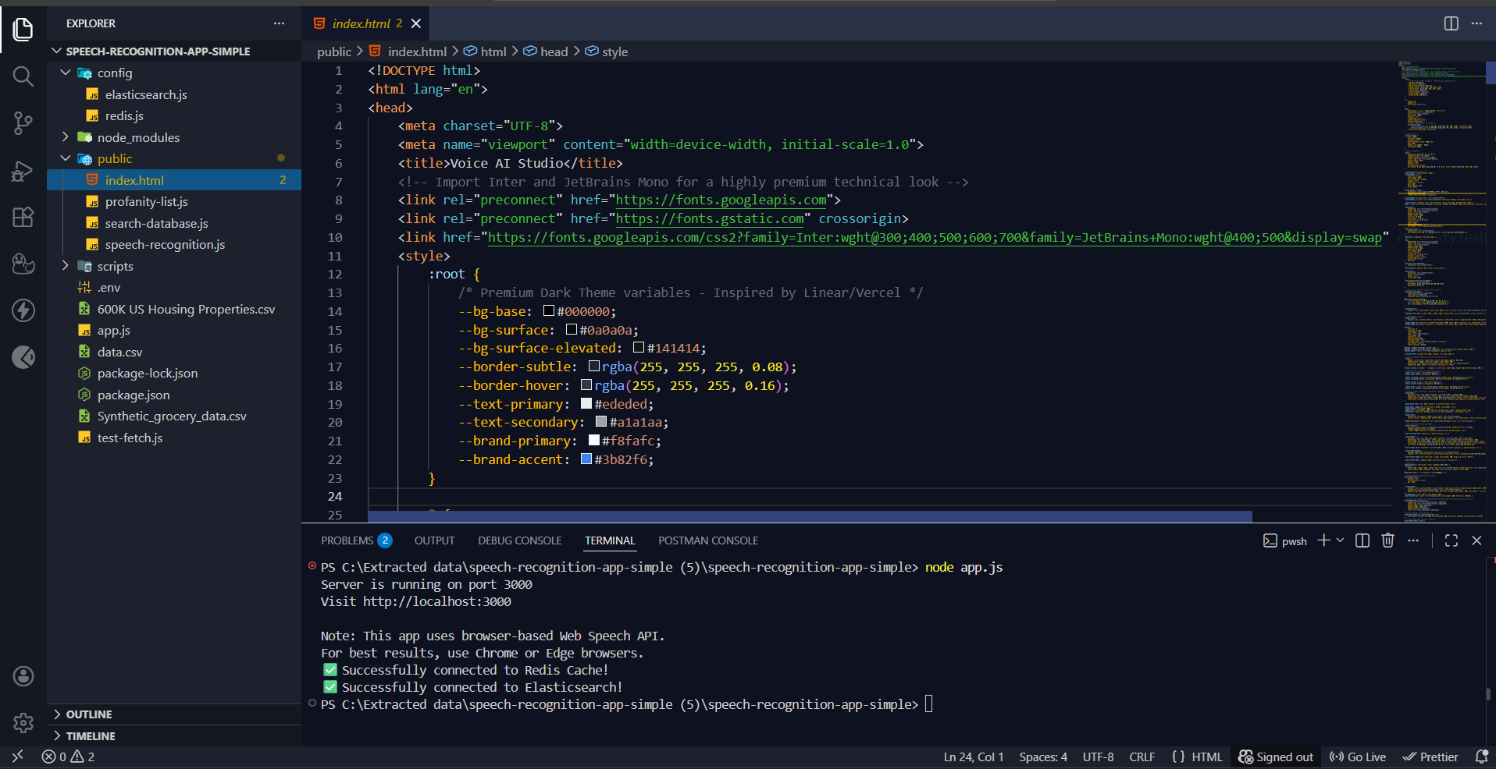
IMPLEMENTATION & PROGRESS

Slide 23
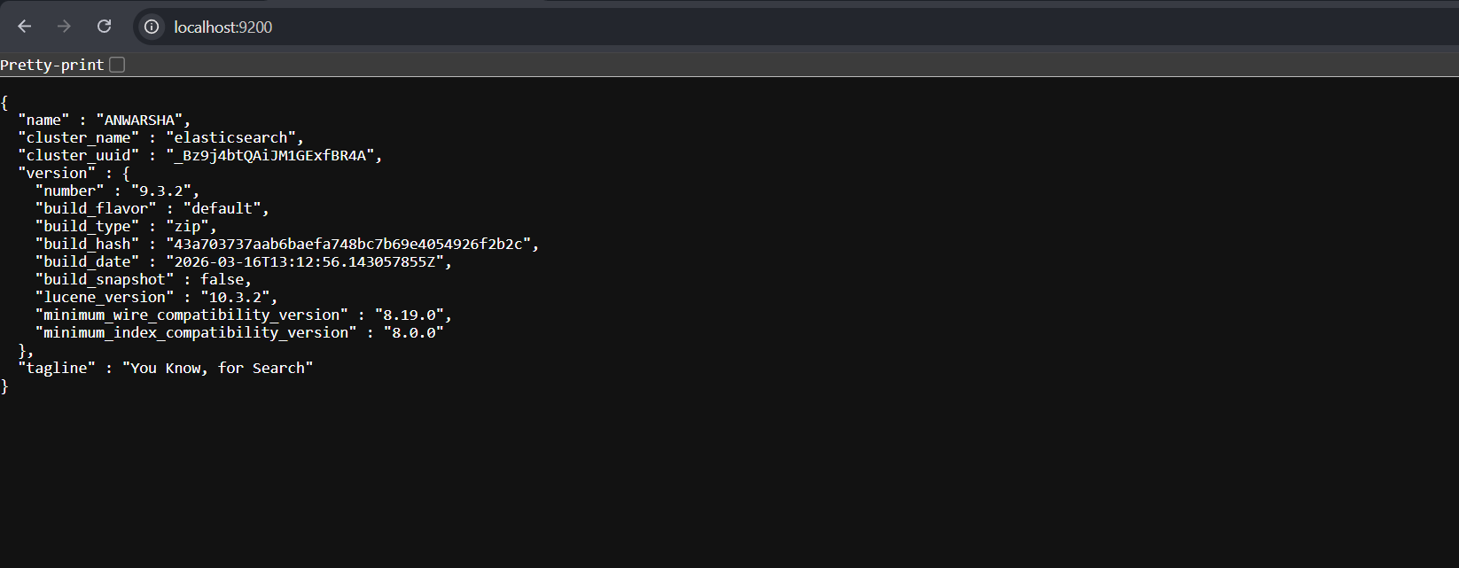
IMPLEMENTATION & PROGRESS

Slide 24
EXPERIMENTAL RESULTS
Traditional SQL Search Time: 200 ms – 1000 ms
Elasticsearch Search Time: 20 ms – 150 ms
Redis Cache Response Time: 0.1 ms – 2 ms
Redis provides near-instant response for repeated queries
Significant reduction in response time using caching
Improved system performance and scalability
High accuracy in retrieving relevant results
Consistent and reliable performance across queries

Slide 25
COMPARISON WITH EXISTING SYSTEM
Feature | Existing System (SQL) | Proposed System
Search Speed | High Latency (200-1000 ms) | Very fast (1-20 ms)
Caching | Not available | Redis Caching
Search Method | Sequential search | Elasticsearch (Inverted index)
Performance | Slower for large data | High Performance
Scalability | Limited | Highly scalable
Repeated Queries | Reprocessed Every Time | Served from cache
Response Time | Slow | Near-instant
User Experience | Moderate | Improved

Slide 26

PUBLICATIONS
CONFERENCE: International Conference on Smart Innovations in Engineering & Technology (ICSIET 2026)

Slide 27


PUBLICATIONS

Slide 28

PUBLICATIONS

Slide 29
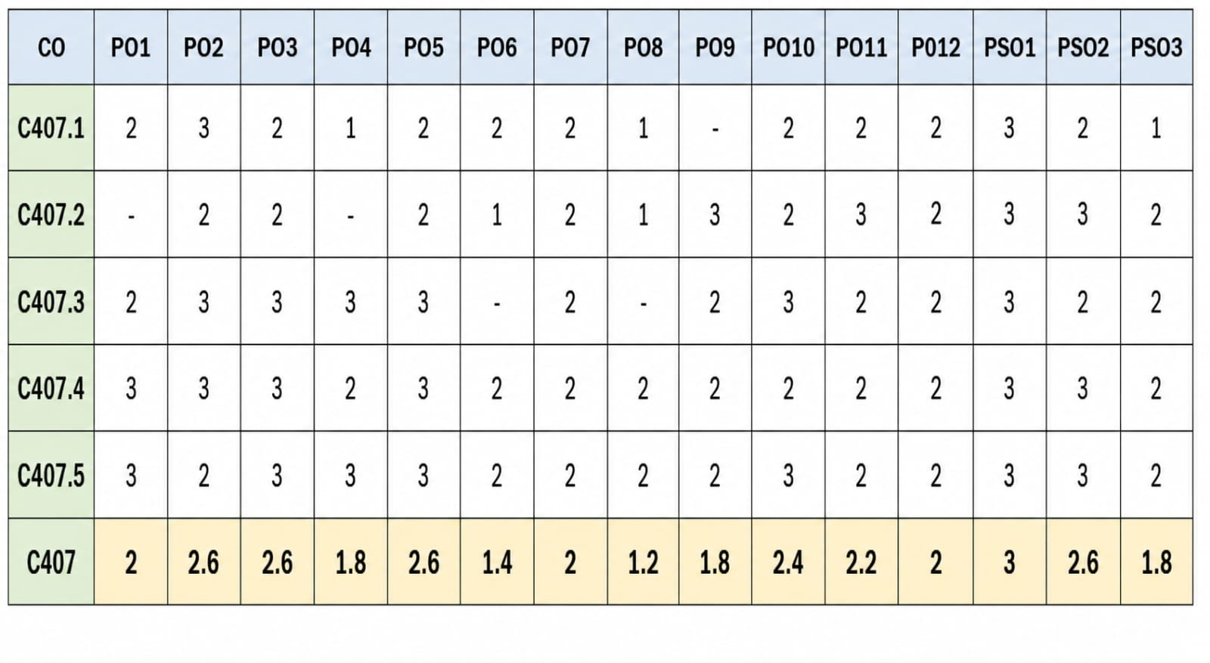
COURSE OUTCOME – PROGRAM OUTCOMES MAPPING

Slide 30
FUTURE WORK
Implement distributed Redis caching for better scalability
Apply machine learning for result ranking and personalization
Integrate NLP for semantic search understanding
Deploy system on cloud for large-scale applications
Enhance security and data handling mechanisms

Slide 31
CONCLUSION
A high-performance search system was developed using Elasticsearch and Redis caching.
The system significantly reduces response time by storing frequently searched queries in memory.
It achieves up to 99% improvement in performance while enhancing scalability and efficiency.
The proposed system is well-suited for real-time applications such as e-commerce and enterprise systems.

Slide 32
REFERENCES
[1] Y. Zhu, T. Xia, T. Zhu, Z. Zhao, K. Li, and X. Hu, “RAPO: An Automated Performance Optimization Tool for Redis Clusters in Distributed Storage Metadata Management,” IEEE Access, vol. 13, pp. 58060–58071, 2025, doi: 10.1109/ACCESS.2025.3556240
[2] N. Kathare, O. V. Reddy, and V. Prabhu, “A Comprehensive Study of Elasticsearch,” Journal of Research in Science and Engineering (JRSE), vol. 4, no. 11, Nov. 2022.
[3] L. Kaptosv, “Using Redis for Caching Optimization in High-Traffic Web Applications,” International Journal of Advanced Multidisciplinary Research and Studies, vol. 5, no. 4, pp. 1714–1722, 2025.
[4] Elasticsearch B.V., “Elasticsearch Documentation,” [Online]. Available: https://www.elastic.co
[5] Redis Labs, “Redis Documentation,” [Online]. Available: https://redis.io.
[6] ReEF. Scholer, H. E. Williams, J. Yiannis, and J. Zobel, “Compression of Inverted Indexes for Fast Query Evaluation,” Proc. ACM SIGIR, 2002.
[7] Meta Platforms, “React – A JavaScript library for building user interfaces,” [Online]. Available: https://reactjs.org
[8] PolarTech, “500,000+ US Homes Data for Sale (Properties Dataset),” Kaggle,[Online].Available:https://www.kaggle.com/datasets/polartech/500000-us-homes-data-for-sale-properties. Accessed: Apr. 2026.

Slide 33
THANK YOU

